Slide 1
Cog*ify
BWSI Cog*Works 2023
By: Rohan Dugad, Medha Mittal, Khoi Nguyen, Aadi Shah, Aswin Surya, and Pyae Sone Hmine (TA)

Slide 2



Problem
Maintain excitement with high energy music
Spend more time with your friends
OR
Which do you choose?

Slide 3


No DJ? No problem!

Slide 4
01
02
03
Deployment pipeline
Training pipeline
Demo
04
05
Music Video Generation
Future improvements
The creation of Cog*Ify
Cog*Ify in action
Good ol’ machine learning
Diffusion models!
Cog*Ify 2.0?

Slide 5
Deployment pipeline
How does the program work?

Slide 6
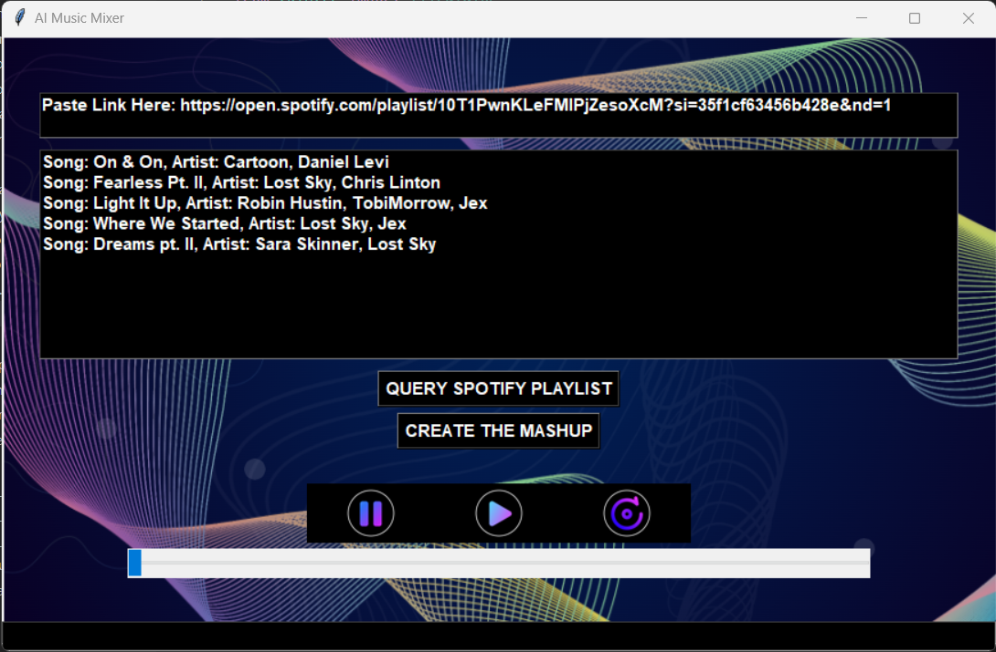
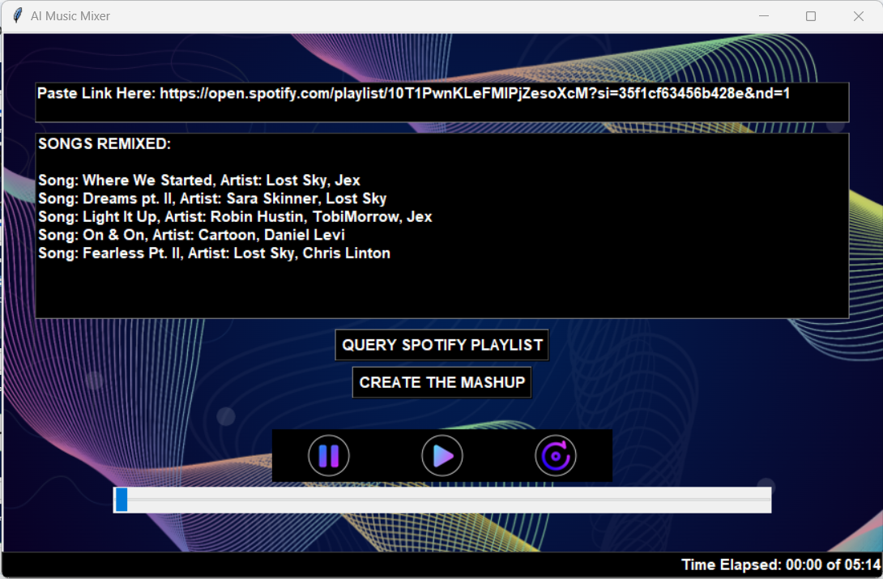
Graphical user interface
Input the Spotify playlist link
Query Spotify Playlist
Create the Mashup
Song order is updated

Slide 7
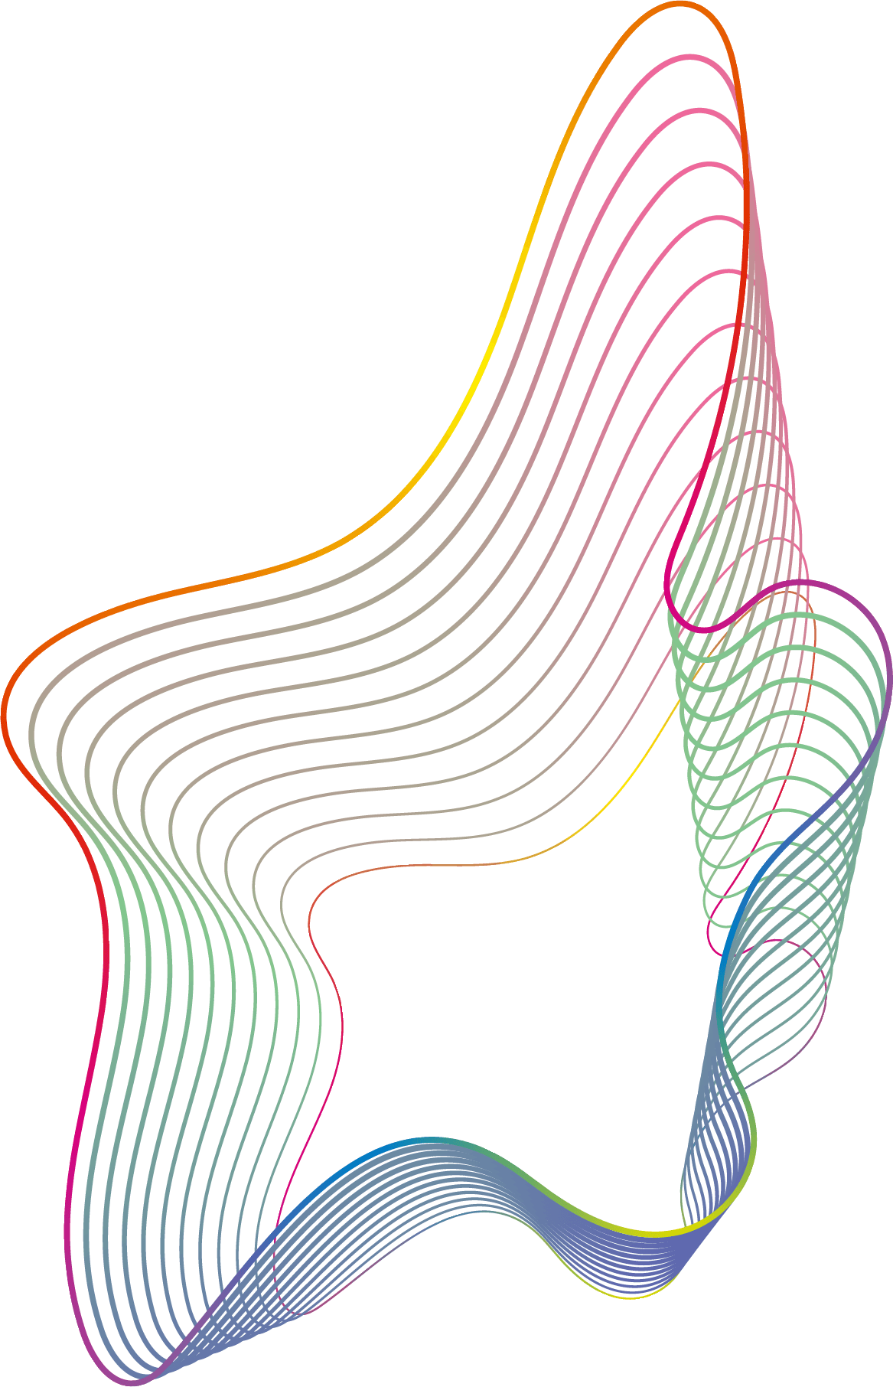

Getting (NCS) Song data
Spotify API
Youtube API
Scraping song data
ClippinG Songs
Use Spotify’s built in API to get the song names and artists in a playlist
Use Youtube’s search api to get videos of the songs from the spotify playlist
Scrape the song metadata from YouTube
Send the data to the model to get timestamps and then clip the songs

Slide 8
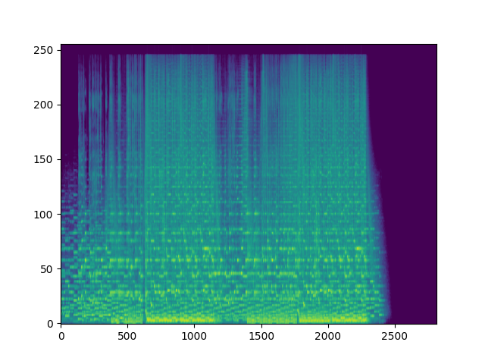

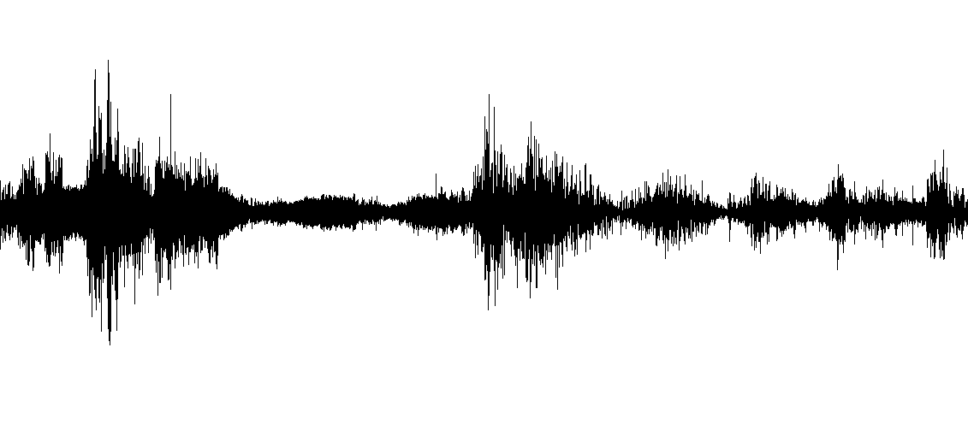
Generate spectrograms

Slide 9
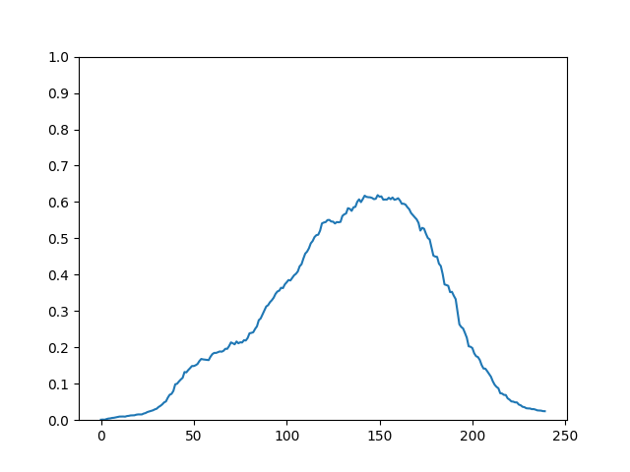
Model prediction

Slide 10
Model prediction

Slide 11
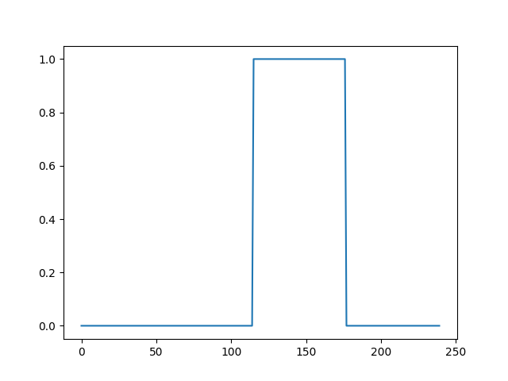
Model prediction

Slide 12
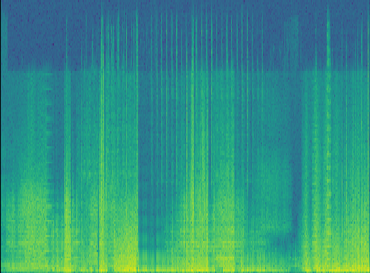
Spectrograms
20000 -
17500 -
15000 -
12500 -
f [Hz]
10000 -
7500 -
5000 -
2500 -
0 -
100 200 300 400 500
t [sec]

Slide 13
Cosine similarity

Slide 14
Determining the best order
First song
NEXT SONG
REPEAT
Order complete
Find which song has the highest cosine similarity to the first song.
For all songs in playlist, use cosine similarity to find next unplayed song.
Pick a random song to play first using the random module.
The order has been determined. . . next transitions!

Slide 15
Adding transitions between songs
Fade in
crossfade
Fade out
Apply a 4 second fade in to the first song in the mashup.
Apply 2 second crossfades between songs.
Apply a 4 second fade out to the last song in the mashup.

Slide 16
Final product
Pause and unpause the mashup whenever you want!
Replay the music!
Skip to other parts of the mashup!
Check how far you are in the mashup!

Slide 17


Slide 18
training pipeline
How was the model made?

Slide 19
Training pipeline
Create dataset
Generate spectrograms
Extract best time stamps
Train model

Slide 20
Training pipeline
Create dataset
Generate spectrograms
Extract best time stamps
Train model

Slide 21



Create Dataset

Slide 22
Training pipeline
Create dataset
Generate spectrograms
Extract best time stamps
Train model

Slide 23
Generate spectrograms

Slide 24
Training pipeline
Create dataset
Generate spectrograms
Extract best time stamps
Train model

Slide 25
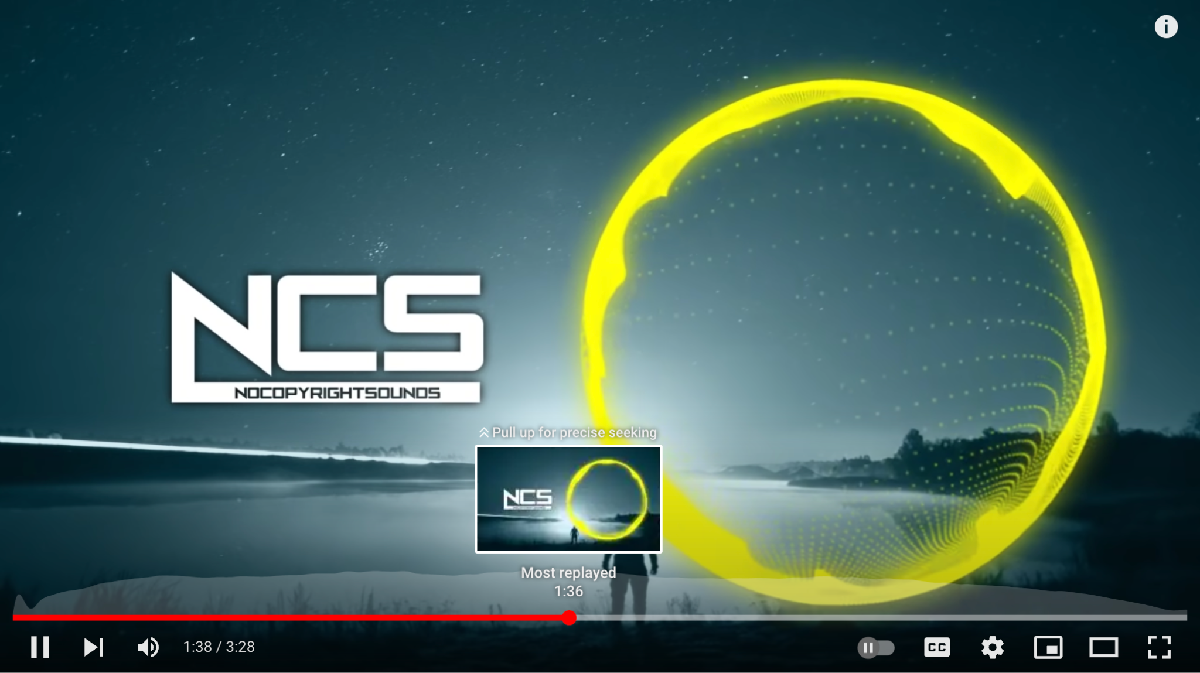
Extract best time stamps

Slide 26
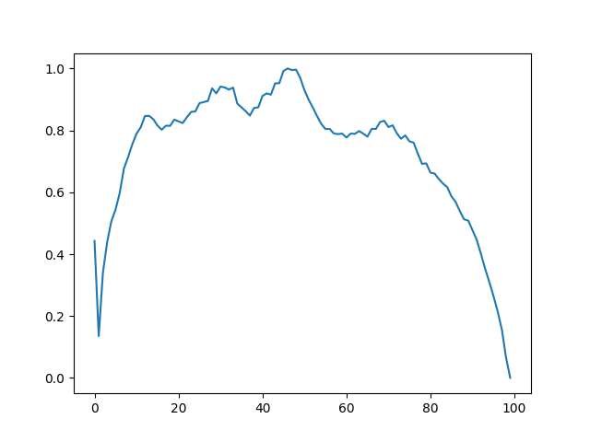
Extract best time stamps

Slide 27
Extract best time stamps

Slide 28
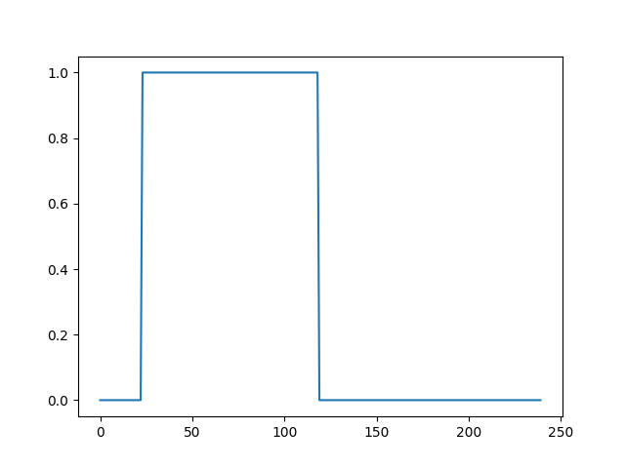
Extract best time stamps

Slide 29
Training pipeline
Create dataset
Generate spectrograms
Extract best time stamps
Train model

Slide 30
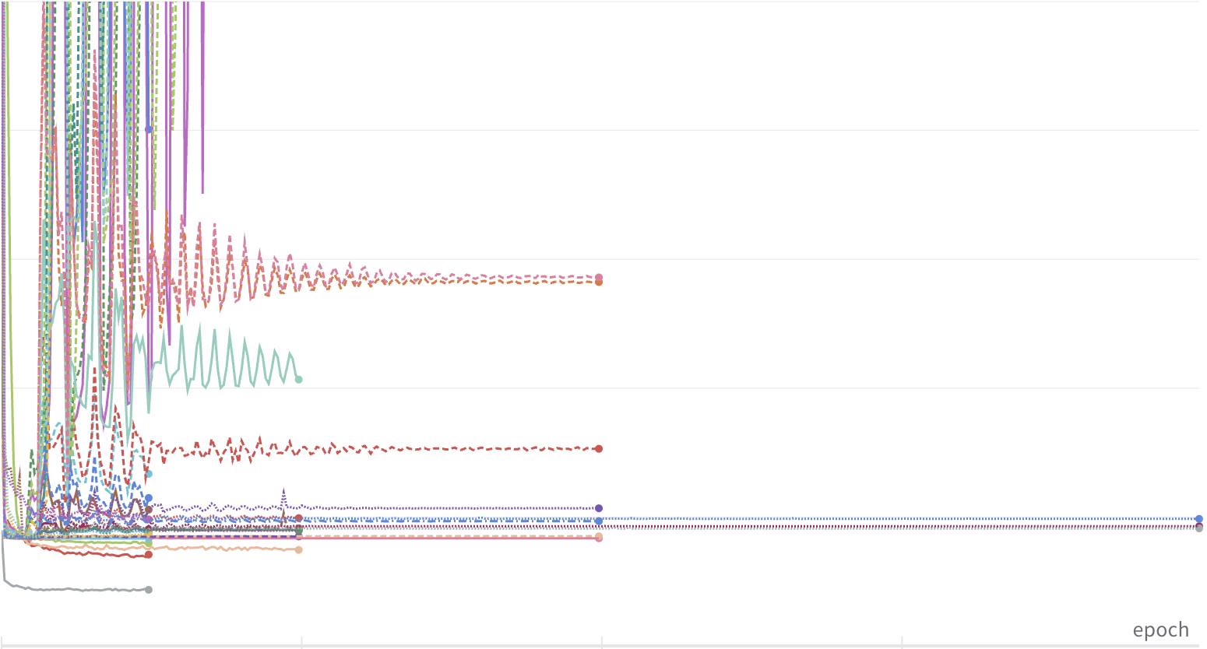
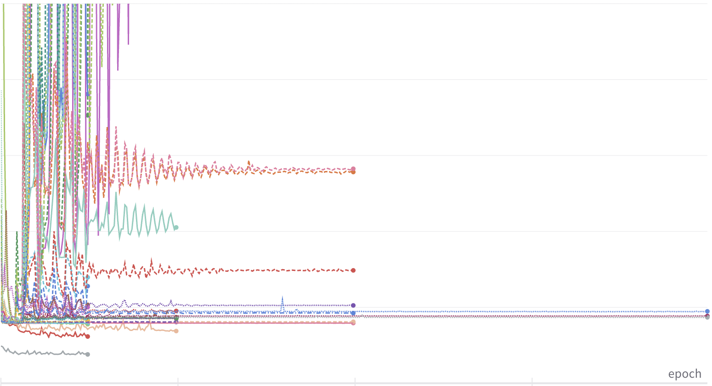
Hyperparameter optimization
Loss
Validation Loss
Epochs
Epochs

Slide 31
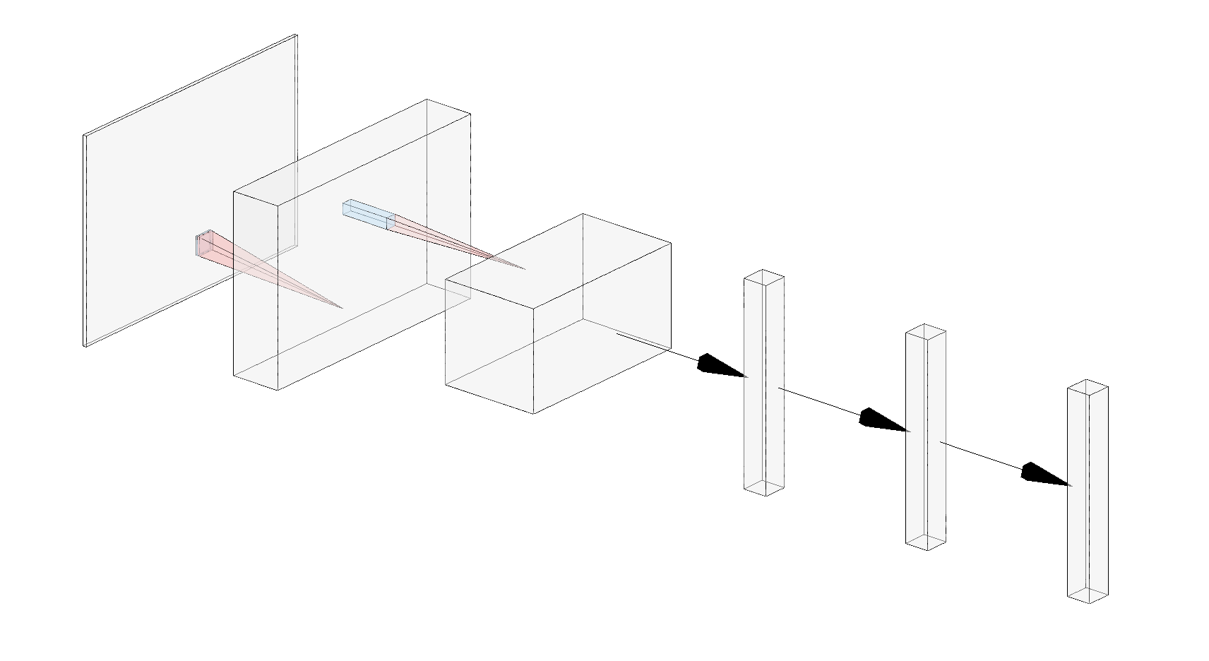
Model architecture & Hyperparameters
2813
1407
Dense Layers
256
176
128
16
1
4
16
Convolutional Layers
256
256
240

Slide 32
Music video generation

Slide 33
Automated Music Video generation
Diffuse
Interpolate
Synchronize
Play
Input prompt to HuggingFace’s Stable Diffusion to generate images
Gradually move from vector of one image to another for smooth transition
Match the image frames to beats of music using spectrogram analysis
Utilize PyGame to play audio with images and save video

Slide 35
FUTURE IMPROVEMENts
Music Video GUI
Own playlist
Improve accuracy
Integrate music video generator into GUI & create prompts based on song lyrics
User identifies genre and preferences -> program creates new playlist
More memory and higher resolution spectrograms

Slide 36
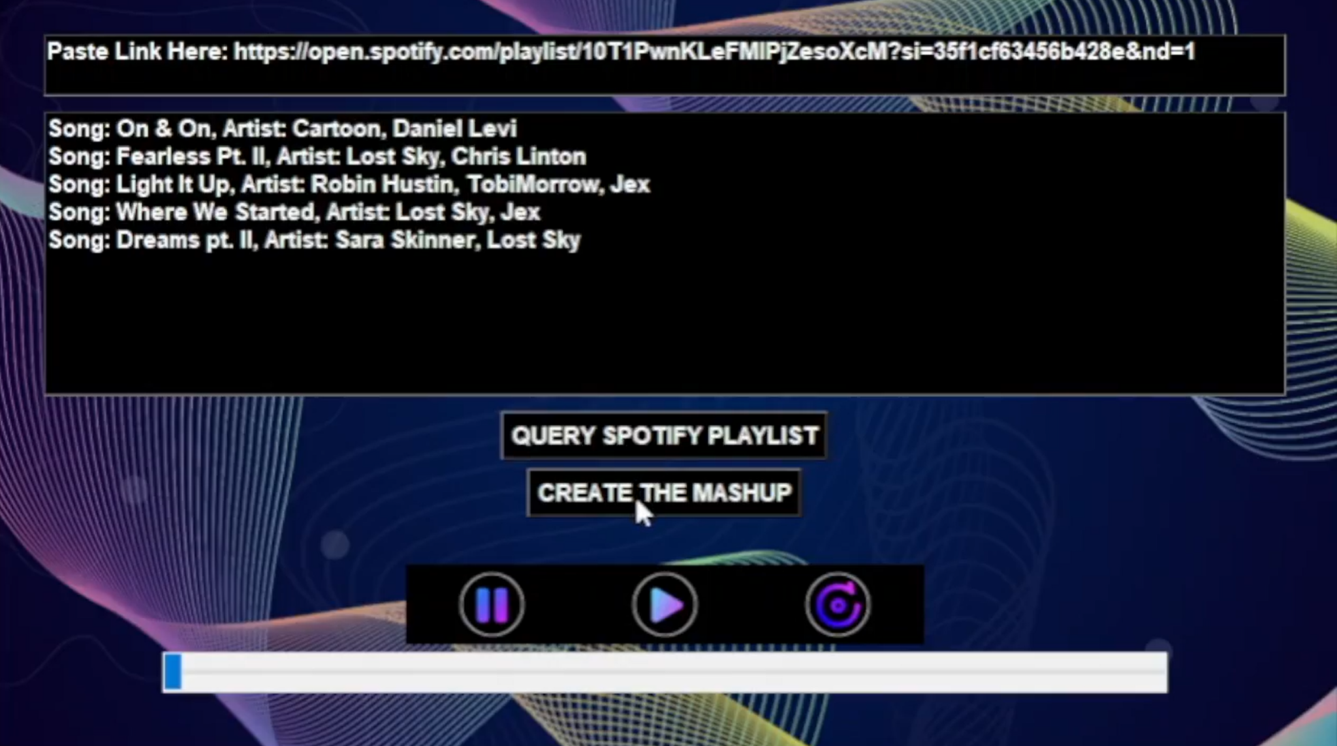

Recap
Problem: Playing music without a DJ
Solution: Automated DJ With Cog*Ify
Generated Spectrogram
Extracted timestamps
Trained CNN
Deployed gui
Created music video

